Slide 1
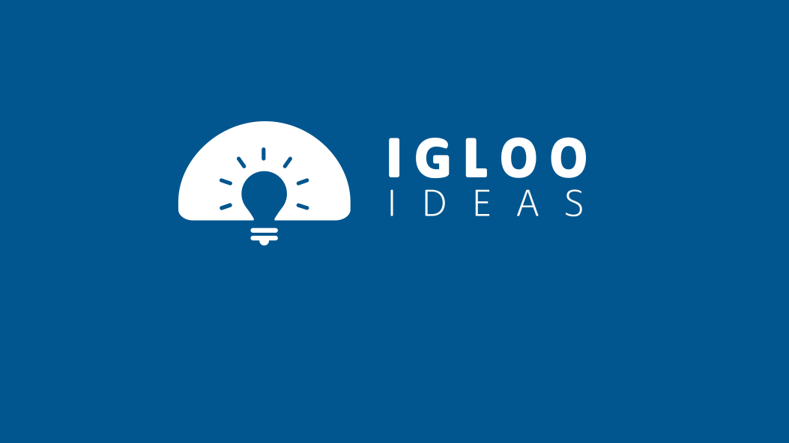
Wild Spear Logo Presentation

Slide 2


Logo Option – 1
TRAVEL BUDDIES

Slide 3


Logo Option – 1 “TRAVEL BUDDIES”
Feel / Proposition : Fun, Social, Holiday, Online, Travel, Modern
Theme : The “W” in the first part of the logo is redesigned for representing and optimizing the concept of “Travel Buddies”
First part of the W & the second part of the W represents the hands of two travelers holding each other’s hands.

Slide 4

Logo Option – 2
Adventure - Travel – Life (Travel Club)

Slide 5
Logo Option – 2 “Adventure - Travel – Life (Travel Club)”
Feel /proposition : Travel Culture, Retro/Vintage, Travel Club, Community, Inspiration
Theme : This option is dealt with a retro/ vintage style logo as retro is the metaphor for Travel culture. It depicts great depth and aesthetic value to the company and represents Wild spear as a new “Travel Culture” emerging in India.

Slide 6
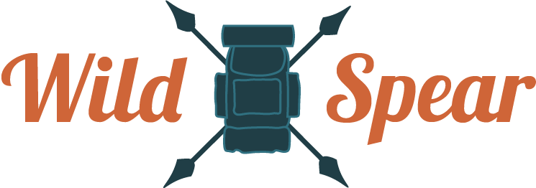
Logo Option – 2 “Adventure - Travel – Life (Travel Club)”
Other Options

Slide 7



Logo Option – 2 “Adventure - Travel – Life (Travel Club)”
Other Options

Slide 8

Logo Option – 3
Negative space Logo – Inspiring to Travel

Slide 9
Logo Option – 3 “Negative space Logo – Inspiring to Travel”
The Shape filled with Orange is representing wild spear’s “W”
Feel / Proposition : Friendly, Inspirational, Classy, Modern, Trustworthy.
Theme : This option is dealt with a retro/ vintage style logo as retro is the metaphor for Travel culture. It depicts great depth and aesthetic value to the company and represents Wild spear as a new “Travel Culture” emerging in India.

Slide 10

Logo Option – 4
“Explore the world with Wild Spear”

Slide 11
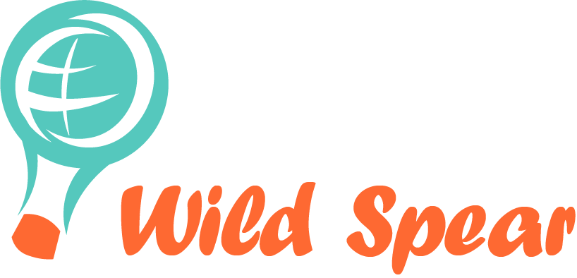
Logo Option – 3 “Flying around the world”
Feel / Proposition : Friendly, Inspirational, Classy, Modern, Trustworthy.
Theme : Concept "fly all around the world" Parachute- travel, joy, holiday, traveling together, fun, new, exciting, flying etc. World graphic on parachute- travel all around the "world"

Slide 12
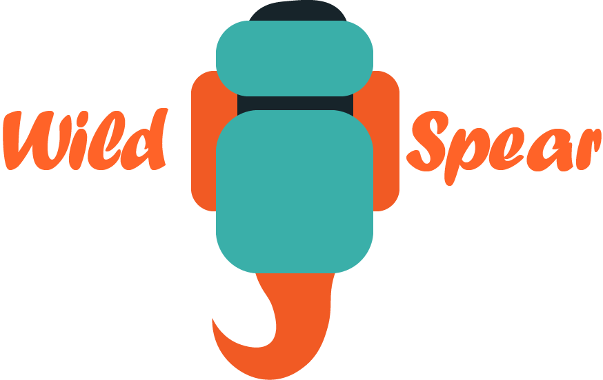
Logo Option – 4
Explore the world with Wild Spear

Slide 13

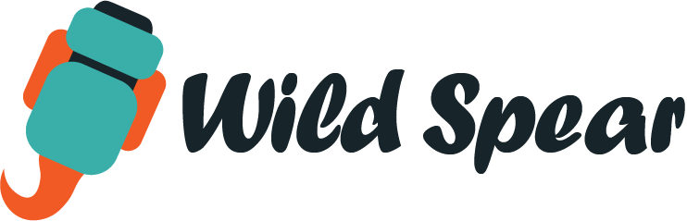
Logo Option – 3 “Gypsy Soul”
Feel / Proposition : Friendly, Social, Gypsy Soul, Travel freaky, Inner Desires, Searching for something new, Traveler, Quest, Fun Adventure, Minimaalistic.
Theme : This Logo best fits for the name & theme of the Company. As proposed, gypsy soul is the one who always wants to find new things/Places in his life. The logo represents an imaginary character that is turned back wearing a travel bag and looking for something new & Exciting.

Slide 14
THANK YOU

